Slide 1
Learning About Angular
To see the main Demo example:
open a command prompt and run:
Git clone https://github.com/johnpapa/angular-tour-of-heroes.git
Then cd into the cloned folder and run:
npm install
When everything is installed, run:
NPM start
Then you can see the project at localhost:4200

Slide 2
About Me:
I’m Kristen
I work at Microsoft, on the Xbox Live team
My main (current) project is a mobile-first web app that charts Xbox Live Performance
Technologies used include: C# (.Net Core 2.0), Elasticsearch, TypeScript, Angular, D3.js
Contact info:
Twitter: @kristenmthayer
Email: kristenmthayer@gmail.com

Slide 3
A Few Notes About Angular
Angular 2.0 and above are now called “Angular” (“not Angular 2/4”), any 1.0 version is “AngularJS”. They are really, really different. If you have the choice, pick the newest version.
Most Angular apps are written in TypeScript, which compiles into JavaScript. TypeScript is similar to strongly typed languages.
Angular relies on webpack, which I won’t be covering.
Angular projects can be generated and managed with the Angular CLI, which I won’t be covering.
This is just a high level overview of what Angular can be used for.

Slide 4
Why Use Angular?
Imagine that you want to build a bookshelf…
Or a set of bookshelves…
Or a set of sturdy bookshelves
(“sturdy” means my two-year-old can climb on them)
Or several sets of sturdy bookshelves, for your friends
Or several sets of sturdy bookshelves, to sell
Or mass produce lots of sturdy bookshelves, for IKEA
Mistakes that you make in a single handmade bookshelf get more serious as you scale to mass production.
Upfront investment in producing a good bookshelf also pays off as you get to mass production

Slide 5
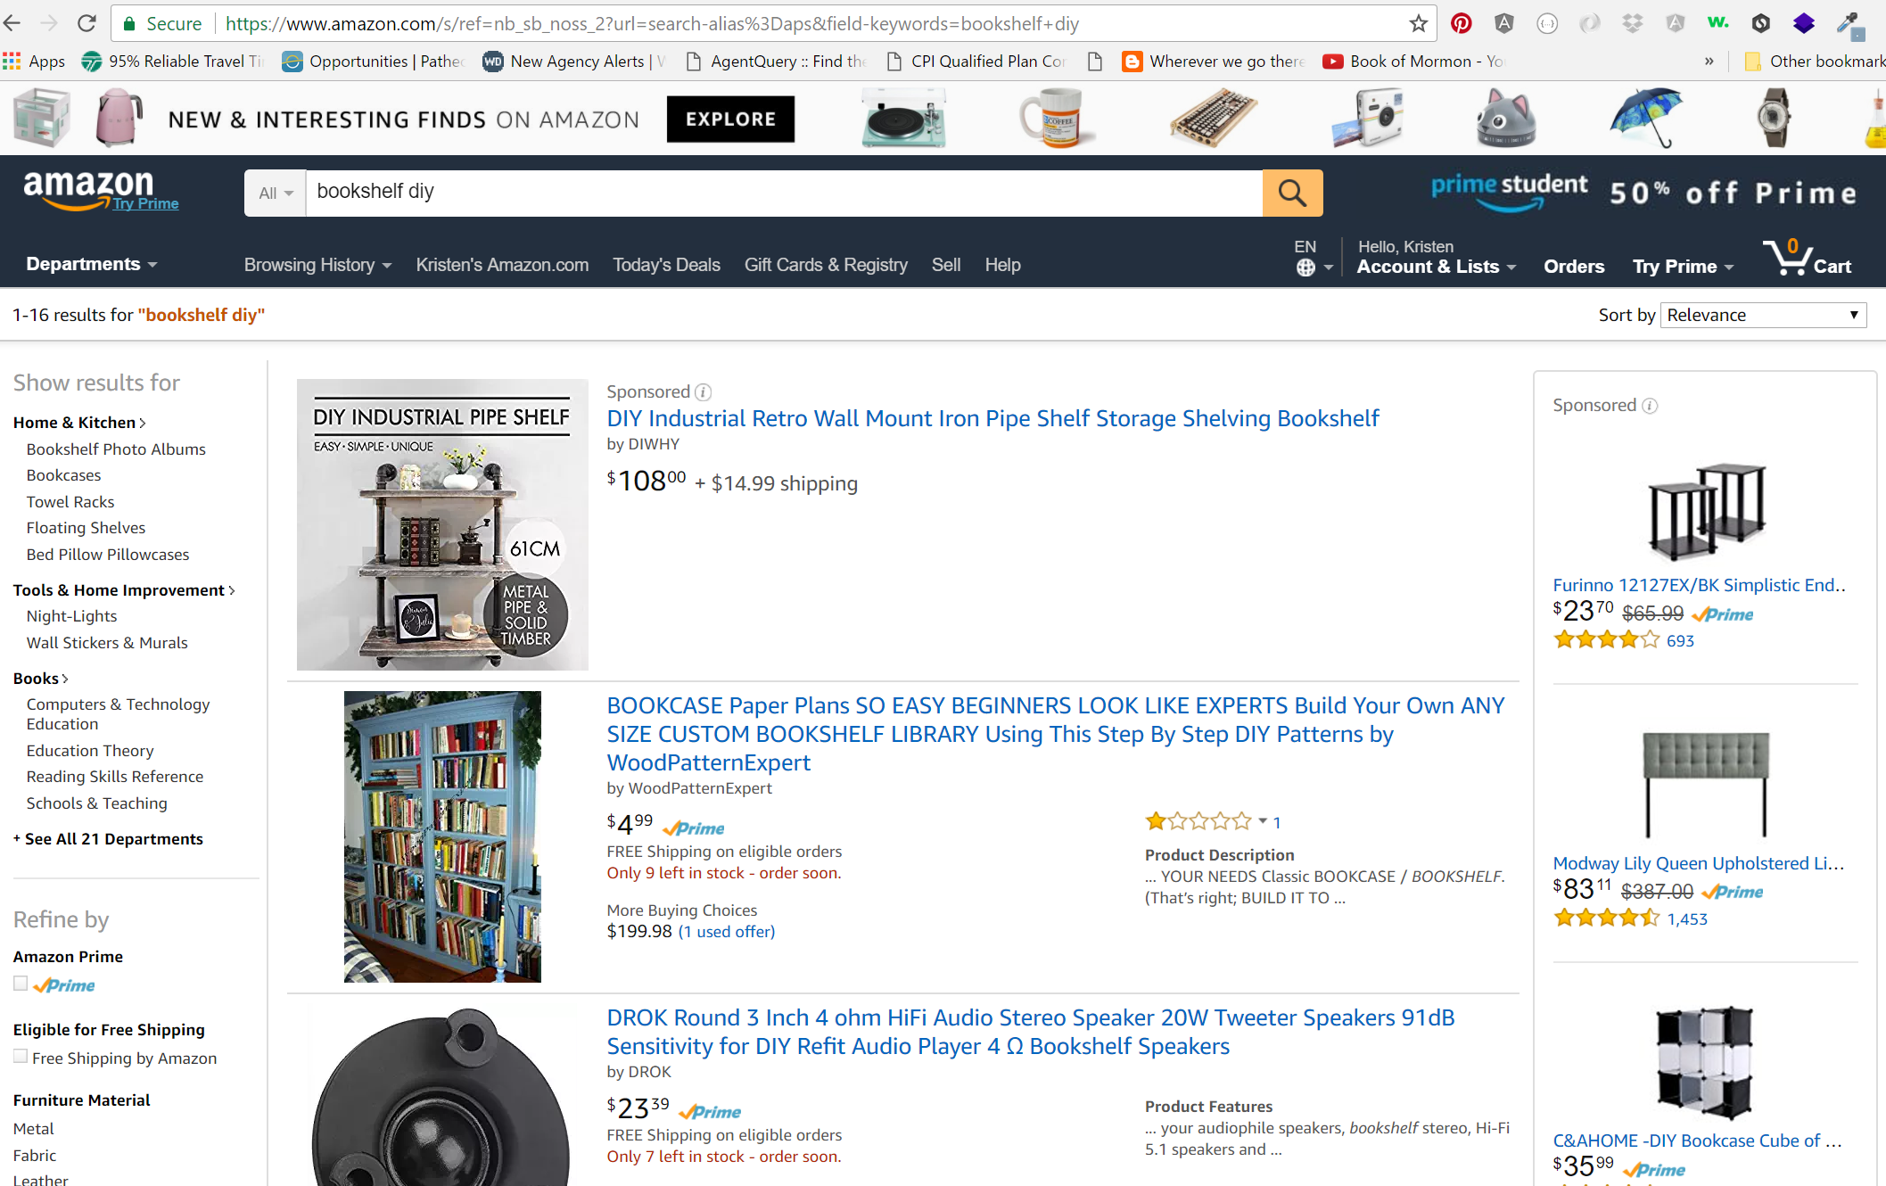
Components in Angular
Components are the building blocks of your application. Imagine building a site like Amazon.com:

Slide 7
Component components
Most components have a .ts file (TypeScript), a .css file, and a .html file. These are grouped together in the app structure.
Each component attaches to the main app using custom selector tags:
<my-component></my-component>
Services that get data for components are usually .service.ts files.

Slide 8
Data Flow in Angular
Angular has two-way data binding.
() markers send data from html to js/ts
For example, in html:
<myComponent>
<div (click)=“myClickFunction($event)”>Click Here!
</div>
</myComponent>
[] markers send data from js/ts to html
<myComponent [class]=“specialClass”></myComponent>
[()] markers (“banana in a box”) are two-way
<div>
<label>name: </label>
<input [(ngModel)]="hero.name" placeholder="name" />
</div>

Slide 9
More Angular Goodies
Directives:
*ngIf:
<div *ngIf="hero">
<h2>{{hero.name}} details!</h2>
</div>
*ngFor:
<div *ngFor=“let hero in heroes">
<h2>{{hero.name}} details!</h2>
</div>
{{}} for interpolation
Backticks on templates:
template:
`<h1>{{title}}</h1>
<div class="header-bar"></div>`
Pipes (x | uppercase) can be looked up in documentation.

Slide 10
Still MORE Angular Goodies
Decorators,
constructors,
dependency injectors,
modules,
services
and MORE…
But it’s easier to see some of those in an actual project (in a minute).

Slide 11
Combines easily with TypeScript and RxJs
So you can make and export custom classes, like Book or Book[].
Book.title
Book.wordcount
Book.price
You can also use things like
Observables,
Subscriptions,
Flatmap and Map,
let and const,
and ALL THE FUN JAVASCRIPT THINGS!

Slide 12
But don’t get intimidated!
There’s always a lot to learn, and you have to start somewhere.
Angular is really in demand right now, so even knowing a little is a good start.
Frontend changes all the time, so you’re not that far behind “experienced” developers if you challenge yourself to keep learning.
Let’s look at a project! (this is the example project from the Angular website)

Slide 13
Resources to learn more
Angular docs:
https://angular.io/docs/ts/latest/
Angular blog:
https://blog.angularjs.org/
Codeschool’s course:
https://www.codeschool.com/courses/accelerating-through-angular
Egghead’s courses:
https://egghead.io/technologies/angular2
https://egghead.io/courses/introduction-to-reactive-programming
TypeScript site:
https://www.typescriptlang.org/

